Slide 1
I Am the Light of the World
John 8: 12-21

Slide 2
I Am the Light of the World
An interesting note
John 7: 53-John 8: 11
Was not recorded in the earliest manuscripts
That is not to say the passage is inaccurate
Nor is this to say this passage is not about Christ’s ministry (Isa 42: 3)
What this does say to us is that the passage is not in chronological order within the context of John 7 & 8
Therefore we must read John 7: 40-52 and read the remainder of the story from John 8: 12 onward

Slide 3
I Am the Light of the World
The setting
This is the last (John 7: 34 “great”) day of the feast of Tabernacles
This feast commemorated the journey of the Israelites through the wilderness
John 7: 37… water… remember Meribah…
Water came forth from the rock…
“If anyone is thirsty… let him come to Me and drink”

Slide 4
I Am the Light of the World
The setting further clarified
John 8: 20… ”in the treasury”
Question…
Where is the treasury located?
Answer in the court of the women
How do we know that?
Widow with two mites… (Luke 21: 1-4)
To be a widow you have to be a woman

Slide 5
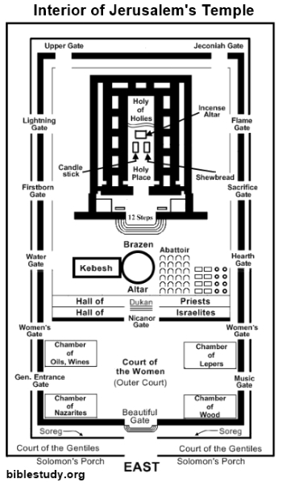

Slide 6
I Am the Light of the World
Why would it be important for this tidbit to be in the narrative?
Remember… the water has just been poured out
Jesus cries out in a “loud” voice
If anyone is thirsty… let him come to Me
The altar is located in court of the priests
So what is happening now in the court of the women where the treasury is located?

Slide 7
I Am the Light of the World
The lighting of the candelabras
All around the court of the women
Large candelabras…
Commemorating what?
Exodus 13: 21-22
Exodus 24: 16-18
Numbers 9: 15-23
So when these candles are lighting up the temple area
Jesus spoke to them saying…
“I AM” the Light of the world” (John 8: 12)

Slide 8
I Am the Light of the World
Note what Jesus did not say…
He did not say I am…
The light of the temple
The light of Jerusalem
He said ”I AM the Light of the world”
Why would He say that to the Jews?
Isaiah 42: 1-7
“as a light to the nations” (Isaiah 42: 6)
Isaiah 49: 5-6
“may reach to the end of the earth”

Slide 9
I Am the Light of the World
Isaiah 9: 2… the coming of the Messiah
Isaiah 52: 6-10
(Isaiah 52: 10) “that all the ends of the earth may see”
“I AM”
Tetragrammaton…
Exodus 3: 13-14
John 1: 1-5
“Did not comprehend it”
John 8: 13
Pharisees became indignant

Slide 10
I Am the Light of the World
Your testimony is not true
Deuteronomy 17: 6; John 8: 17
Go back to John 7: 46
“Never has a man spoken like this man”
Pharisees reaction
John 7: 47-48…
No amount of proof will ever be enough for those who refuse to acknowledge Christ for who He is
Consider these things…

Slide 11
I Am the Light of the World
Pharisees…
Interrogated the man born blind… (John 9: 32-34)
John 12: 9-11… Lazarus
Healed the man at the pool (John 5)
Feeding of the 5,000 (John 6)
So why would the law demand 2 or 3 witnesses?
I Timothy 1: 8-10
John 8: 46… which one of you?????

Slide 12
I Am the Light of the World
John 8: 14
“I know where I came from and where I am going”
John 17: 1-6
John 8: 18
Where is your Father?
John 8: 41
John 8: 19
If you knew Me, you would know the Father also

Slide 13
I Am the Light of the World
John 8: 21
Reminiscent of John 7: 34
Why would Jesus reiterate this statement?
II Peter 3: 9
“The Lord is patient toward you, not wishing for any to perish”
Isaiah 51: 8
“And My salvation to all generations

